Slide 1
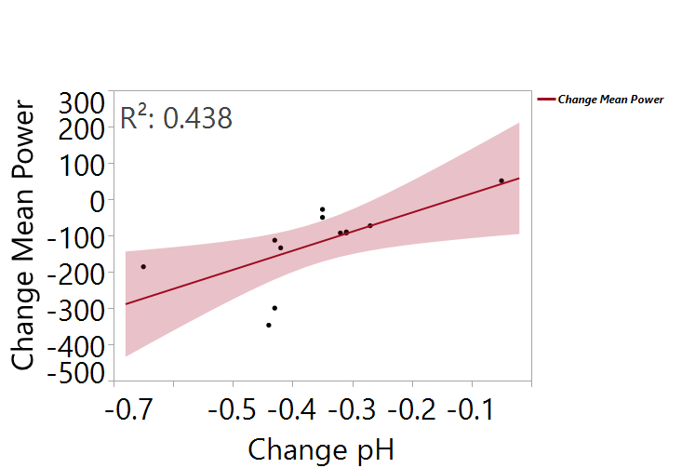
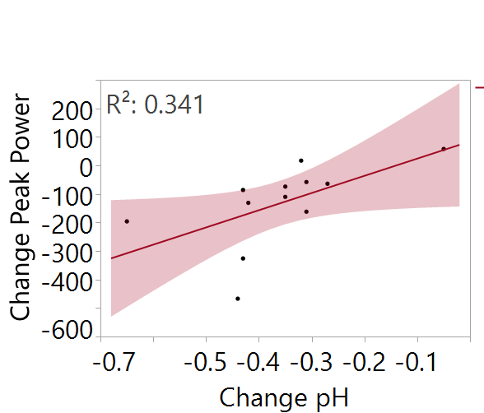
Changes in blood pH and ammonia following repeat sprint performance
Greggory R. Davis¹, Jordan Perett¹, Danielle Rudesill¹, David Bellar¹
¹University of Louisiana at Lafayette, Lafayette, LA
ABSTRACT
MATERIALS AND METHODS
The relationship between relative intensity and changes in blood pH and ammonia are not well characterized. PURPOSE: The primary aim of the study was to determine how changes in relative exercise intensity following repeat sprint performance affect changes in blood pH and blood ammonia concentrations. METHODS: Healthy college-age males (n = 12) completed one 30 second Wingate cycle sprint test as a familiarization trial. A minimum of 48 hours after the familiarization trial, participants returned to the lab. Resting venous and capillary blood samples were obtained to determine blood ammonia, pH, and lactate levels. Participants then completed 3 Wingate sprint tests, separated by 5 minutes each. Finger capillary blood was immediately obtained after each test to determine lactate and pH values. After the final test, an additional venous blood sample was obtained to determine blood ammonia values. RESULTS: Data are shown as 1st vs. 2nd vs. 3rd tests, respectively. There was a significant effect for time for peak power (750.08 ± 39.55 vs. 675.42 ± 30.01 vs. 615.60 ± 37.72 Watts); F = 4.66, p = 0.05, mean power (632.67 ± 30.71 vs. 561.25 ± 22.16 vs. 524.40 ± 26.46 Watts); F = 5.04, p = 0.04, pH (7.72 ± 0.01 vs. 7.63 ± 0.02 vs. 7.62 ± 0.02); F = 70.18, p < 0.01, and lactate (12.36 ± 1.14 vs. 14.10 ± 1.13 vs. 16.95 ± 1.22 mg/dL); F= 42.02, p < 0.01. Blood ammonia values did increase from pre- to post-exercise (0.33 ± 0.09 vs. 1.07 ± 0.22 mg/dl); t = 3.62, p < 0.01, but there was no correlation between post-exercise ammonia values and change in peak or mean power. There was a weak, but significant correlation between change in peak power and change in pH (R² = 0.34, p = 0.05) and change in mean power and change in pH (R² = 0.44, p = 0.02). CONCLUSIONS: Greater reductions in peak power and mean power correlated with change in blood pH, but not post-exercise ammonia values.
Participants:
Recreationally active men (N = 12)
Study Design:
Visit #1
Baseline measures and familiarization trial
Visit #2 – minimum of 48 hours later
Resting venous and capillary blood samples collected
30 second Wingate cycle
5 minutes recovery
Measurement of capillary blood pH, lactate
Wingate cycle # 2
5 minutes recovery (pH, lactate measured)
Wingate # 3
5 minutes recovery (pH, lactate measured)
Post-exercise venous blood sample collected
Analysis:
Capillary blood pH was measured via pH microprobe
Venous blood ammonia was measured via spectrophotometry using a commercially availably assay kit
Significant effect for time for pH; F = 70.18 (p < 0.01)
Significant effect for time for lactate; F= 42.02 (p < 0.01)
INTRODUCTION
RESULTS
Although acute changes in blood pH and ammonia have been documented following exercise, the dose-response effects relative to exercise intensity are not well known. In addition, measuring blood pH typically requires a venipuncture, a technique which requires skill and time to complete and therefore, problematic when repeat measurements are required. If blood pH can be measured alongside validated lactate measurements via dermal punctures, repeat measures to validate high intensity excise become highly feasible for any researcher to complete, even on a limited budget or with limited staff. Thus, the primary aim of the study was to determine how changes in relative exercise intensity affect changes in blood pH and blood ammonia concentrations. The secondary aim was to determine if capillary blood pH is an effective method to validate exercise intensity.
Significant correlation between change in mean power and pH (p = 0.02) and between peak power and pH (p = 0.05)
Post-exercise ammonia values (1.07 ± 0.22 mg/dl) were significantly higher than pre-ammonia values (0.33 ± 0.09 mg/dl) ; t = 3.62 ( p = 0.002)
No significant correlation between post-exercise ammonia values and change in peak or mean power
No significant correlation between post-exercise ammonia values and change in pH or change in lactate
CONCLUSIONS
Greater reductions in peak power and mean power correlated with change in blood pH, but not post-exercise ammonia values and changes in capillary blood pH did not correlate with changes in lactate or ammonia. Measuring capillary blood pH may have limited utility to monitor exercise intensity. However, greater sample sizes are necessary in order to generate more definitive conclusions.
Significant effect for time for peak power; F = 4.66 (p = 0.05)
Significant effect for time for mean power; F = 5.04 (p = 0.04)

