Slide 1
PLEASE SIT IN THE FIRST 7 ROWS

Slide 2
◄ Jan 2020 | February 2020 |  |  |  |  | Mar 2020 ►
Sun | Mon | Tue | Wed | Thu | Fri | Sat
 |  |  |  |  |  | 1 PREVIEW DAY
2 Groundhog Day HONORS BOARD MEETING 3pm | 3 | 4 Census Day | 5 | 6 | 7 | 8
9 | 10 | 11 | 12 | 13 | 14 Valentine's Day SCHOLARSHIP APPS DUE | 15
16 | 17 Presidents Day | 18 | 19 | 20 KREWE OF ROUX PARADE | 21 | 22
23 | 24 NO SEMINAR | 25 MARDI GRAS NO SEMINAR | 26 Ash Wednesday NO SEMINAR | 27 NO SEMINAR | 28 | 29

Slide 3
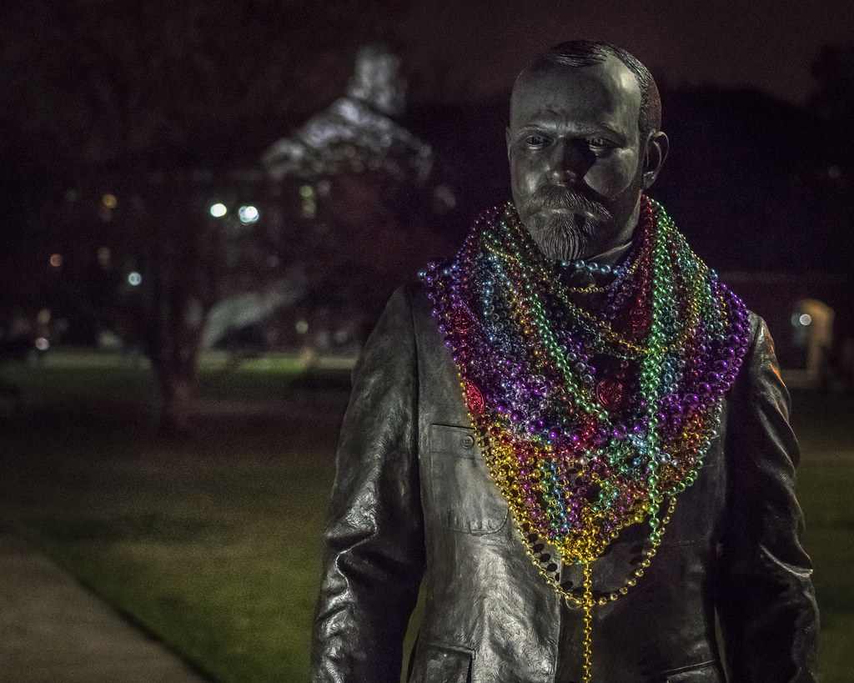
Seminar Feb 17 – Feb 20
SPRING 2020

Slide 4
Per Sapientiam Felicitas
Honors Program Motto:
“Through Knowledge Happiness”

Slide 5
Important Dates Coming Up
Announcing Scholarship Winners: Week of Feb. 19th
Krewe of Roux Parade: Thurs., Feb. 20th
Mari Gras Holidays NO SEMINAR: Mon. – Wed. Feb. 24th -26th
NO SEMINAR: Thurs., Feb. 27th
Louisiana Collegiate Honors Conference: Fri. – Sat., March 5th – March 6th
Literary Rally: Sat., March 6th
Scholarship Awards Ceremony: Tues., March 10th
Contract Requests Due: Fri., March 13th

Slide 6
Seminar Attendance
You should be getting emails tracking your attendance.
Even if you do not get an email your attendance was counted in the system
Check your spam folders.
Remember: it is YOUR responsibility to keep track of your attendance.
The email system is to be used as a backup only.

Slide 7
Krewe of Roux This Thursday

Slide 8
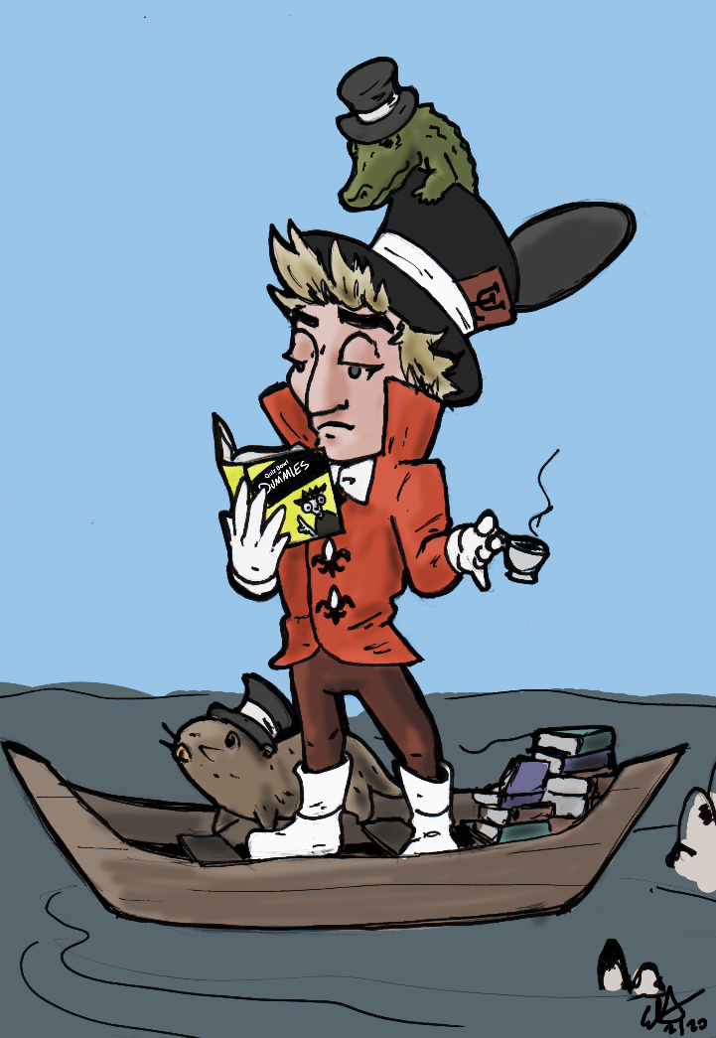
LCHC
**CALL FOR TALENT and PRESENTATIONS
If you have a talent (talent show) or have a research presentation you would like to showcase for the conference, contact julia@louisiana.edu
Last day to sign up for talent show is Friday, Feb. 28th
Sign up for LCHC at the second floor desk in Judice Rickels Hall
Last day to sign up for conference:
Friday, Feb. 21st
LCHC 2020 Theme: “Marsh Madness”

Slide 9
Faith House Donations
MISSION STATEMENT: To provide shelter, safety, empowerment, and advocacy, to survivors of domestic violence.
Accepting these donations:
dish detergent
floor cleaner
spray cleaner
bleach
paper towels
aluminum foil
ziplock bags
size 4 and 5 diapers
paper bowls
plastic cutlery
lysol spray
clorox wipes
1 Service Hour = 4 Items
2 Hour cap but may donate more than 8 items
Donate on second floor Judice-Rickels Hall and sign sheet for hour(s)

Slide 10
Understanding Mental Health
Thursdays @ 5pm in the Quiet Lounge
Feb. 20 Things Might Go Terribly, Horribly Wrong: Coping w/ Anxiety
- Thomas Sease

